Slide 1
Tudor Homes And Buildings
By Ginny Jenkins

Slide 2
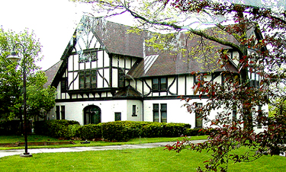
Tudor Homes
From around 1890 – 1940 Tudor homes were popular and being widely built. Today they are not built quite as often, but still are seen as a luxury house to have.
http://www.losaltoshillshistory.org/Resources/Stonebrook-Ct-manor/Life-Percy-Morgan.html

Slide 3
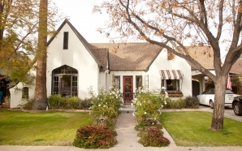
Features
Tudor homes have multiple features that make it obvious that it is a Tudor style home.
Some of these features are blatantly obvious but on occasion it’s harder to see and to tell.
http://www.azcentral.com/style/hfe/coolhomes/articles/2011/02/03/20110203willo-home-tour-tudor-angela-mark-meury.html

Slide 4
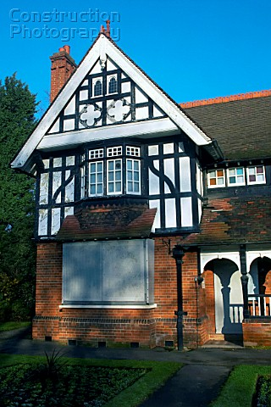
Features
Features of a Tudor home usually include steeply pitched gable roofs, groupings of windows, and exposed timber wood framework filled with masonry or stucco. Common Also is part of the house being stone or masonry.
http://www.constructionphotography.com/Details.aspx?ID=10675&TypeID=1

Slide 5
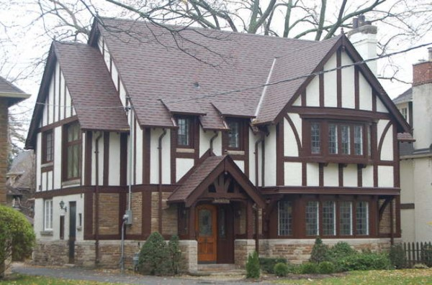
Details
Common details put into a Tudor home include an elaborate masonry chimney with or without chimney pots, an entrance where the door seems to intrude the home due to thicker masonry, a small roof over the door, and all openings arched.
http://thedecorologist.com/how-do-you-paint-a-tudor-style-home

Slide 6
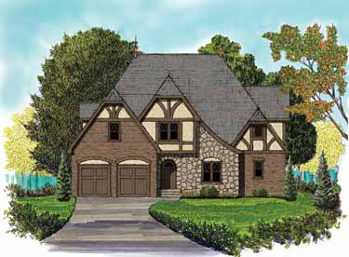
Building Materials
The common building materials include stone, brick, timber wood, and stucco (with or without timber).
http://www.builderhouseplans.com/four-bedroom-english-tudor-home/pid/114715223

Slide 7
Sources
http://www.wentworthstudio.com/historic-styles/tudor

